Slide 1
Telstra Bootcamp
SHUBHAM KUMAR

Slide 2
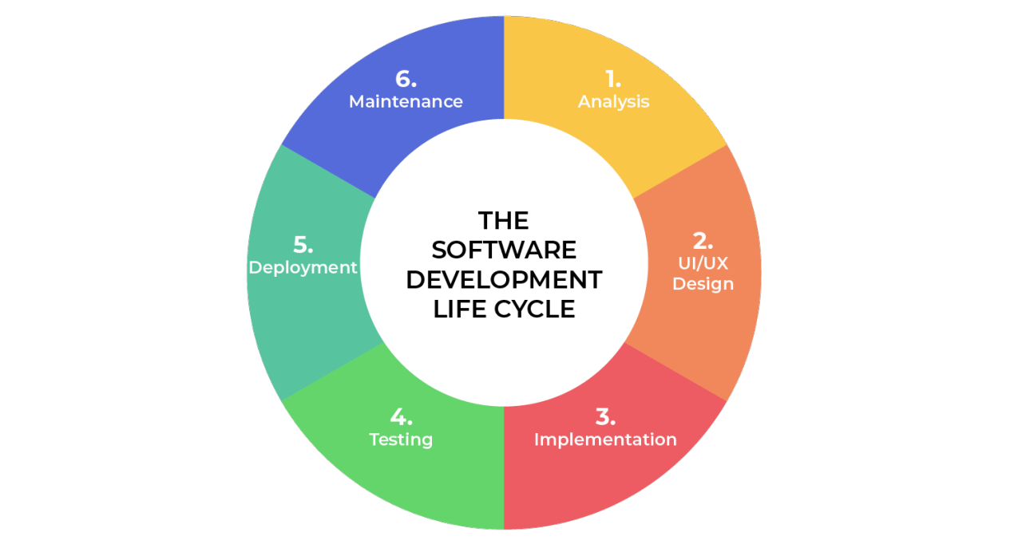
Software Development Life Cycle
Software Development Life Cycle (SDLC) is a structured process for creating, testing, and deploying software applications.
It involves stages like planning, designing, coding, testing, and maintenance, ensuring efficient development and delivery.
SDLC enhances collaboration, minimizes risks, and produces high-quality software solutions.

Slide 3
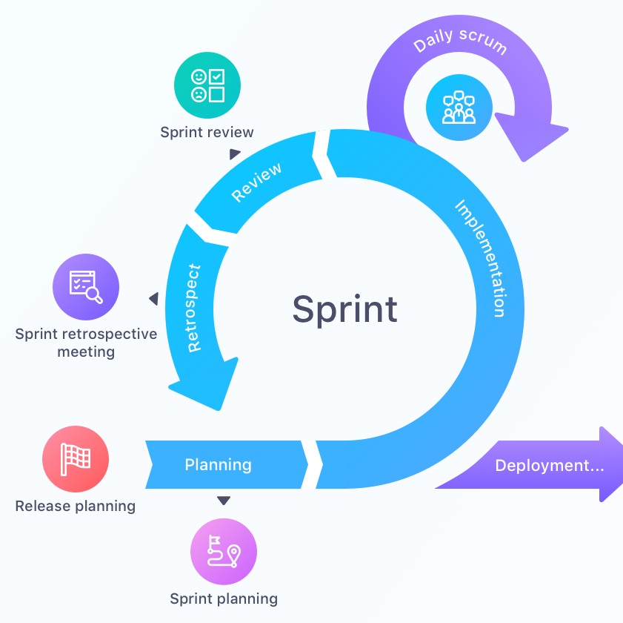
Agile ways of working
Agile methodology is a flexible approach to software development that emphasizes iterative and incremental progress.
Teams work in short cycles called sprints, continuously gathering feedback and adapting to changing requirements.
Agile promotes collaboration, customer involvement, and quick delivery of valuable software

Slide 4

Jira
Jira is a popular project management tool used to track and manage software development tasks.
It enables teams to create, assign, and track issues, tasks, and user stories throughout the development process.
Jira's flexible workflows and customizable boards align well with both traditional SDLC and Agile methodologies, enhancing transparency and efficiency in software development projects.

Slide 5
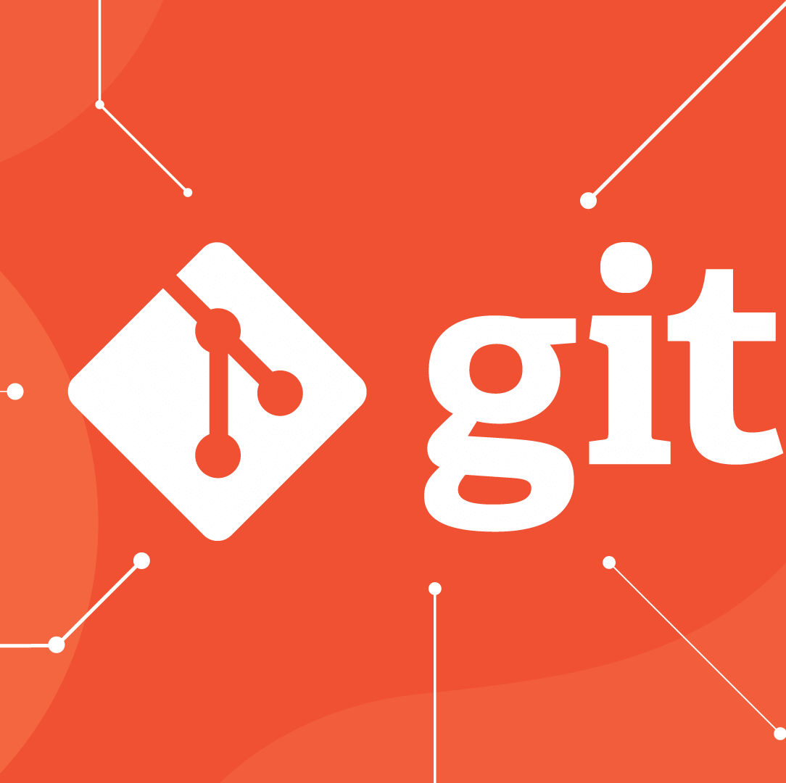
Git
Git is a distributed version control system that enables efficient collaboration and code management in software development.
It tracks changes in source code, allowing developers to work concurrently, merge code seamlessly, and maintain version history.
Git's branching and merging capabilities support Agile development, facilitating iterative changes and continuous integration while ensuring code quality and collaboration.

Slide 6
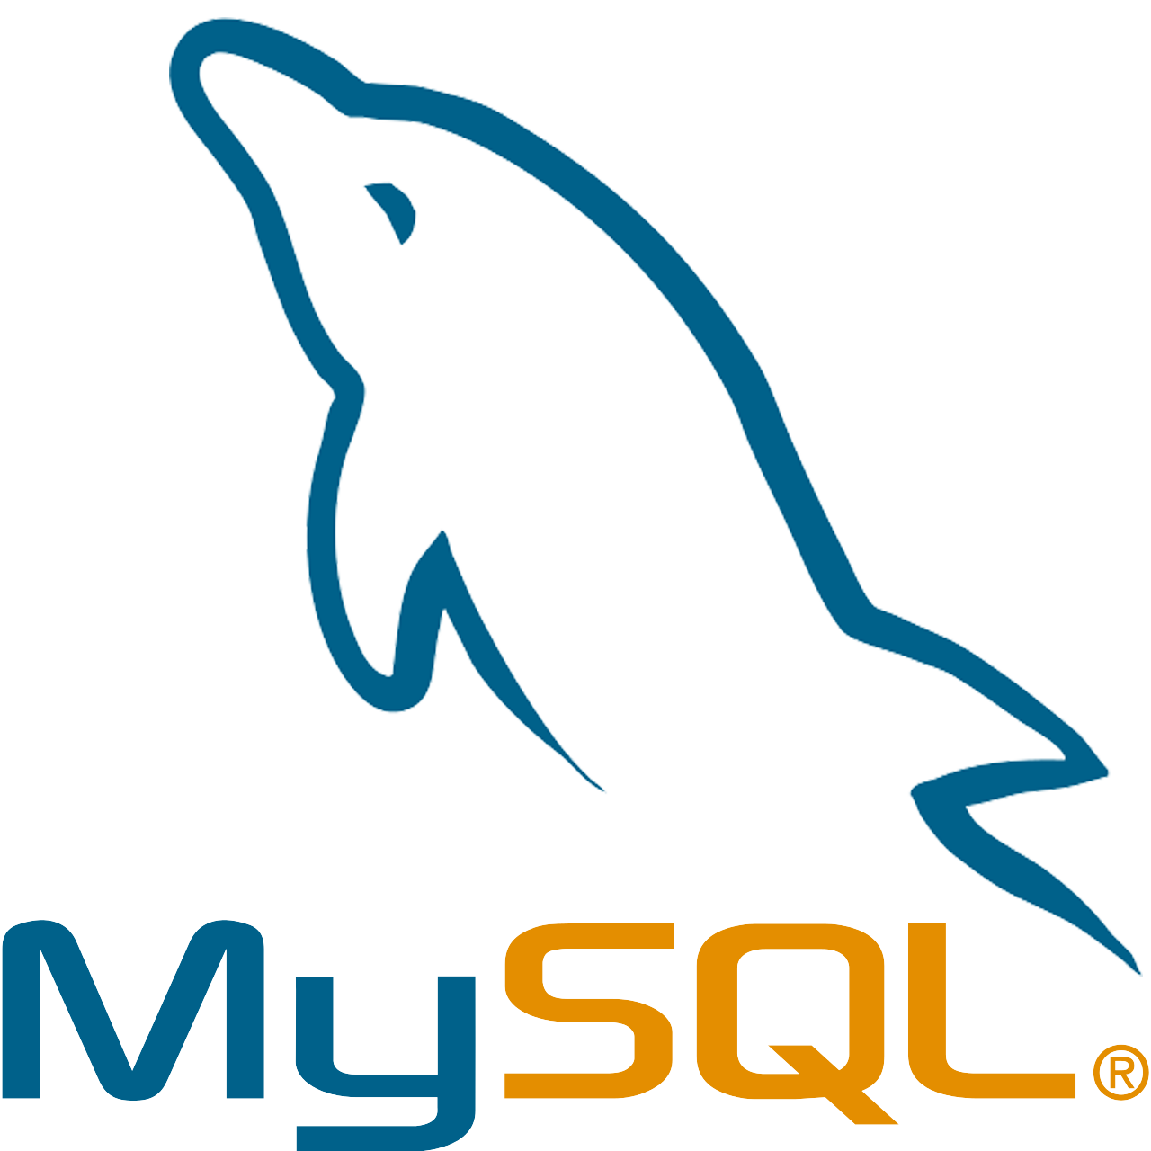
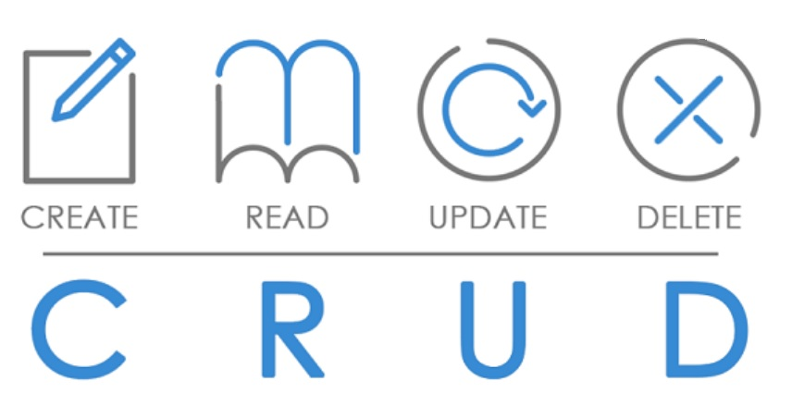
Day-2 MySQL
MySQL is an open-source relational database management system used to store, organize, and retrieve data in various software applications.
It provides a structured way to create, update, and manage databases, ensuring data integrity and efficient querying.
MySQL supports both SDLC and Agile development by enabling developers to design and evolve databases according to changing requirements, fostering reliable data management throughout the software development lifecycle.

Slide 7
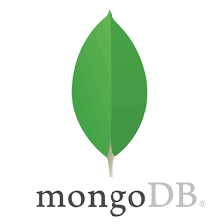
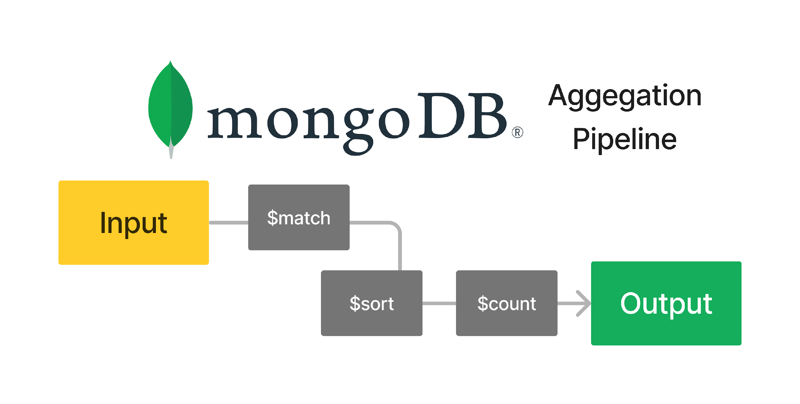
Day-3 MongoDB
MongoDB is a NoSQL database that offers a flexible and scalable approach to storing and retrieving data for software applications.
It uses a document-based model to store data in a schema-less format, accommodating dynamic and evolving data structures. MongoDB's adaptability aligns well with Agile development, allowing teams to iterate quickly, make schema changes on the fly, and manage diverse data types effectively.
It supports modern development practices and enhances collaboration in software projects.

Slide 8
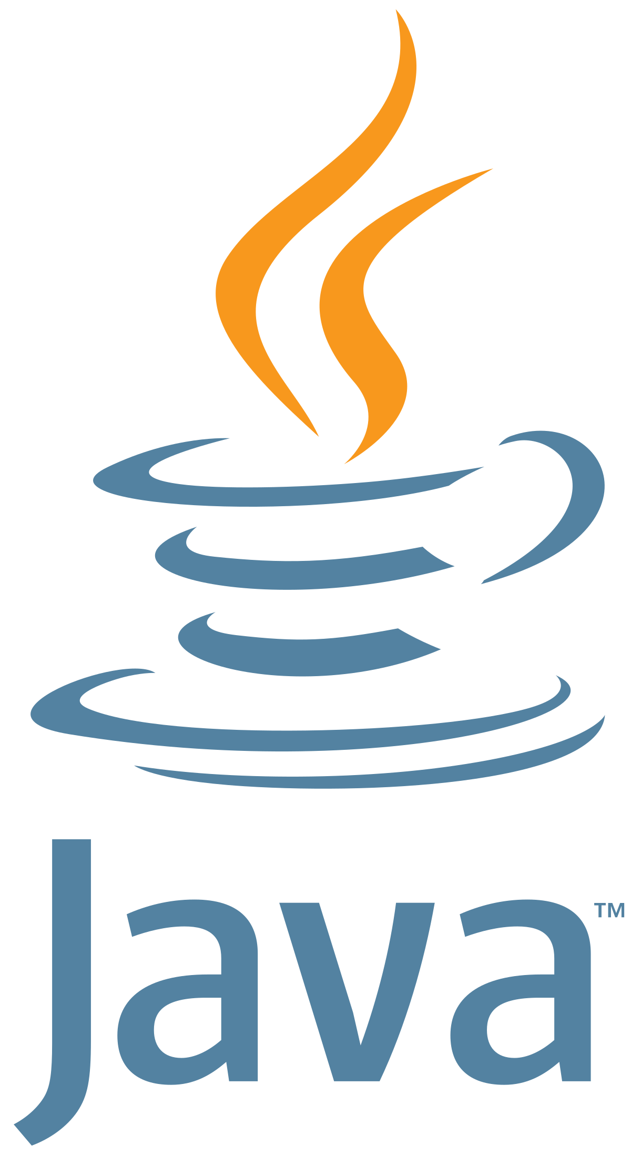
Day-4-6 Core JAVA
Core Java forms the foundation of the Java programming language, providing essential libraries and features for building software applications.
It offers a comprehensive set of tools for developing robust and platform-independent programs.
Core Java supports both traditional SDLC and Agile methodologies by enabling developers to create modular, maintainable code, and its wide range of libraries facilitates efficient development, testing, and deployment.

Slide 9
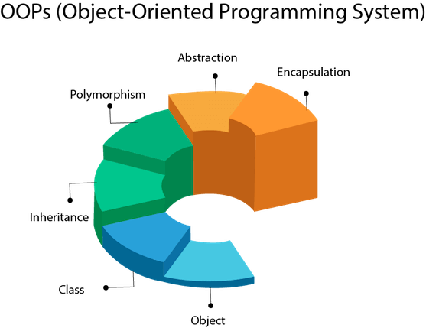
Day-4-6 OOPS in JAVA
Object-Oriented Programming (OOPS) in Java is a paradigm that organizes code into reusable, self-contained units called objects.
It encourages the use of classes and objects to model real-world entities, fostering modular, maintainable, and scalable software development.
Java's OOPS principles—encapsulation, inheritance, abstraction, and polymorphism—promote code reusability, flexibility, and easy maintenance

Slide 10
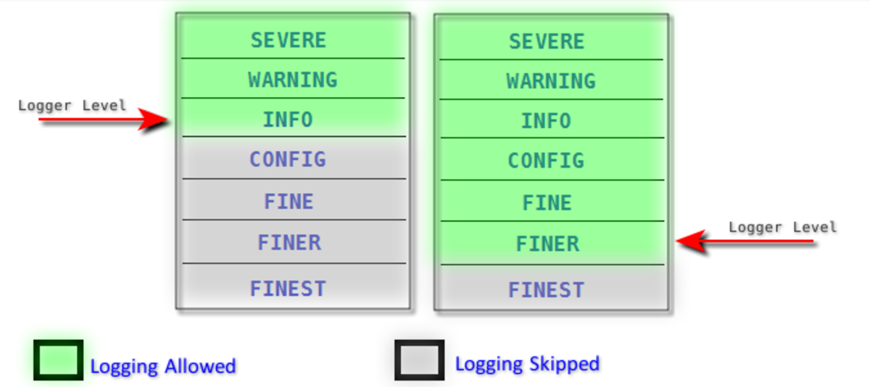

Day-4-6 Logger and Maven in JAVA
Java Logger is a built-in logging utility that facilitates the recording of events, errors, and debugging information in software applications. It ensures proper visibility into the application's behavior and aids in troubleshooting and monitoring.
Maven is a powerful build automation and project management tool. It simplifies project setup, dependency management, and the build process.

Slide 11

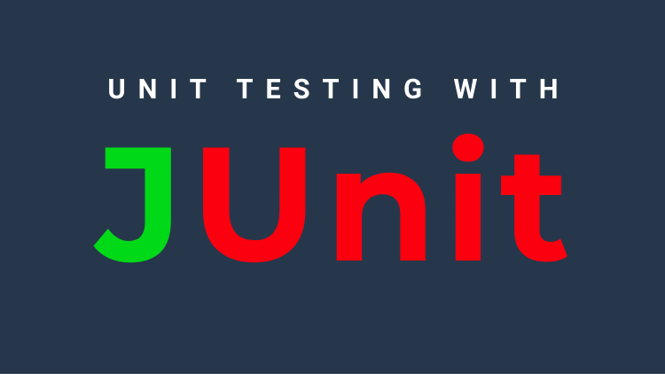
Day-7 Testing - Junit
JUnit is a widely used testing framework for Java that supports the creation of automated unit tests. It allows developers to write and execute test cases to validate individual components of their code.
By ensuring that different parts of the software perform as expected, JUnit enhances code reliability and helps catch errors early in the development process.
JUnit is valuable in both SDLC and Agile practices, as it promotes code quality, encourages continuous integration, and contributes to the creation of robust and maintainable software.

Slide 12

Day-8 Code Management Practices -OWASP
The Open Web Application Security Project (OWASP) is a community-driven organization that focuses on improving the security of software applications.
OWASP provides resources, guidelines, and tools to help developers identify and address security vulnerabilities in their applications.
It supports both SDLC and Agile methodologies by promoting secure coding practices, offering security testing tools, and fostering awareness of potential risks.
Incorporating OWASP principles enhances the overall security posture of software projects, aligning with industry best practices and ensuring the development of secure and resilient applications.

Slide 13
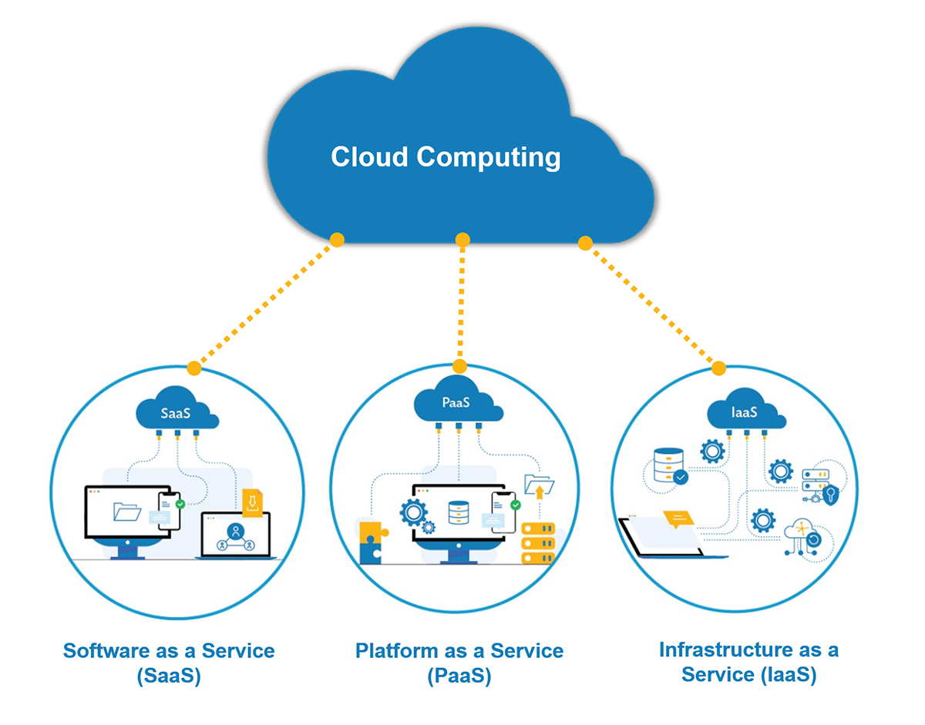
Day-9 Introduction to Cloud
Cloud computing involves delivering computing resources like servers, storage, databases, networking, software, and more over the internet.
It provides scalability, flexibility, and cost-efficiency in deploying and managing applications. Cloud services support both SDLC and Agile by enabling rapid provisioning, continuous integration, and easy collaboration across development teams.
Cloud technology facilitates efficient resource utilization and promotes faster development cycles, aligning with modern software development practices to ensure smooth, scalable, and accessible software solutions.

Slide 14
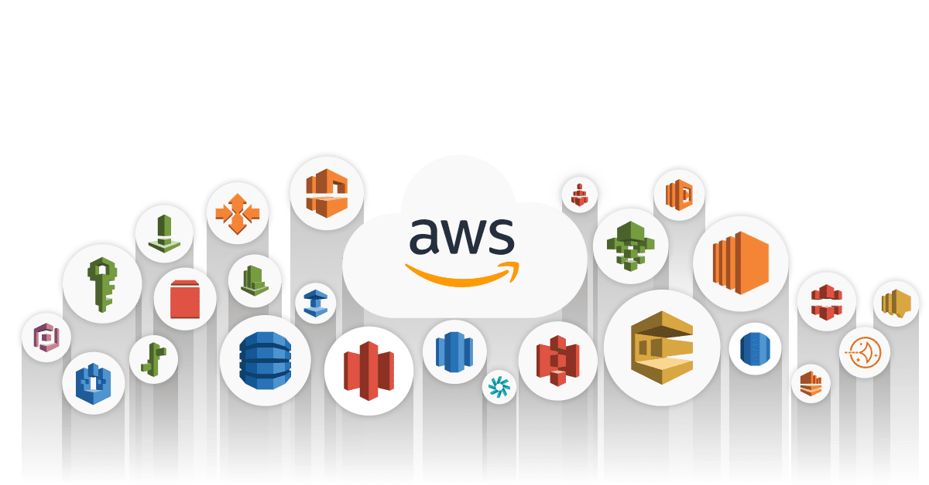
Day-9 Introduction to AWS
Amazon Web Services (AWS) is a leading cloud computing platform that offers a wide range of scalable and on-demand cloud services.
It provides infrastructure as a service (IaaS), platform as a service (PaaS), and software as a service (SaaS) solutions. AWS supports software development across SDLC and Agile methodologies by enabling developers to quickly provision resources, deploy applications, and manage infrastructure efficiently.
Its services like EC2, S3, and Lambda streamline development processes, enhance collaboration, and ensure reliable and scalable software solutions.

Slide 15
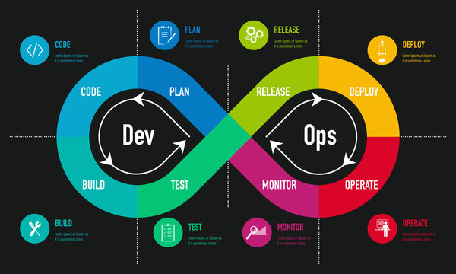
Day-10 Introduction to DEVOPS
DevOps is a set of practices that combine software development (Dev) and IT operations (Ops) to streamline the entire software delivery lifecycle. It emphasizes collaboration, automation, and continuous integration and continuous delivery (CI/CD).
DevOps supports both SDLC and Agile methodologies by fostering efficient communication between development and operations teams, automating repetitive tasks, and ensuring rapid and reliable software deployment.
This approach enhances collaboration, accelerates development cycles, and produces high-quality software solutions with improved efficiency and customer satisfaction.

Slide 16
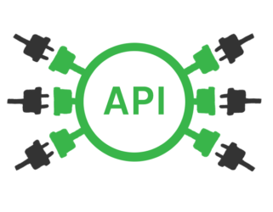
Day-12 Introduction to APIs
DevOps is a set of practices that combine software development (Dev) and IT operations (Ops) to streamline the entire software delivery lifecycle. It emphasizes collaboration, automation, and continuous integration and continuous delivery (CI/CD).
DevOps supports both SDLC and Agile methodologies by fostering efficient communication between development and operations teams, automating repetitive tasks, and ensuring rapid and reliable software deployment.
This approach enhances collaboration, accelerates development cycles, and produces high-quality software solutions with improved efficiency and customer satisfaction.

Slide 17


